Slide 1


Welcome to GEC Academy!

Slide 2
Who we are
2016
GEC Academy was founded in 2016 and has been dedicated to provide high-quality extended educational programs for advanced high school students and college students.
We are GEC Academy!
GEC Academy is China’s leading provider of extra-curricular research opportunities for high school and university students. Together with our network of professional educators, we develop customized online and on-site programs that build bridges between secondary education, post-secondary education, and further work and study.
200+
We are dedicated to work with faculty and researchers from top-30 universities in the US and G5 universities in the UK, and have built relationships with over 200 well-known professors.
30,000+
To date, we have served over 30,000 high schoolers and undergraduate students. Most of them are looking for study abroad, and would like to enrich their academic background, as well as preparing themselves better for future education and even career path.
Notes:
Overall&2016
GEC Academy was founded in 2016. Our headquarter is in Beijing. We also have branch offices in some major cities of China such as Shanghai, Guangzhou, etc. We also have 2 liaison offices in NY and Singapore.
As the leading provider of extra-curricular research opportunities, GEC Academy aims to prepare Chinese high school students and college students for undergraduate and graduate training at top American and British universities by providing a wide variety of online and on-site courses.
200+
We are dedicated to work with faculty and researchers from top-30 universities in the US and G5 universities in the UK, and have built reciprocal relationships with over 200 professors and researchers.
15,000+
To date, we have served over 15,000 high schools and undergraduate students, most of whom are looking for study abroad, and would like to enrich their academic background, as well as preparing themselves better for future education and even career path.

Slide 3
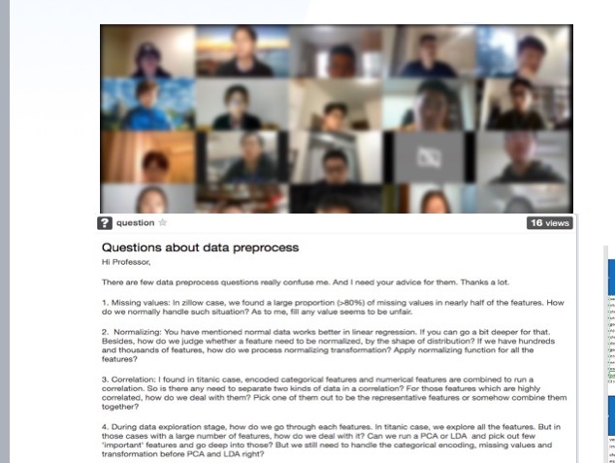
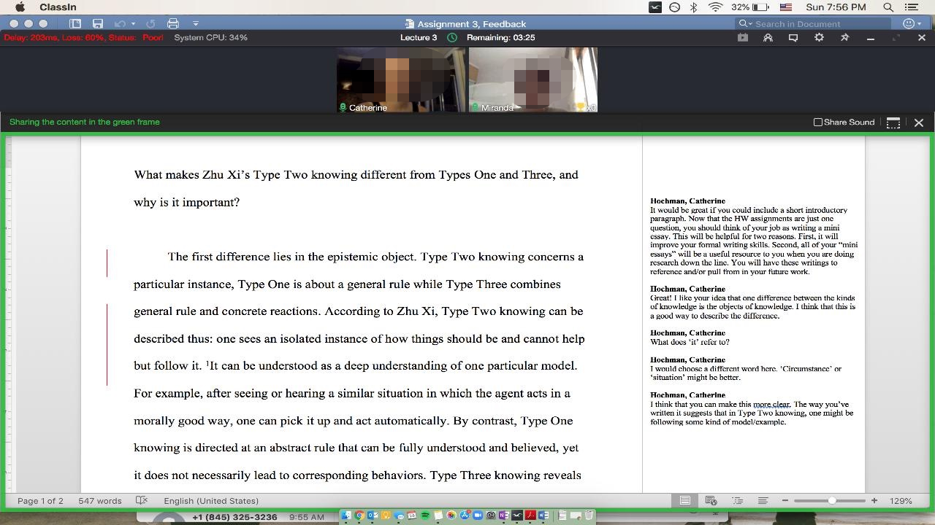
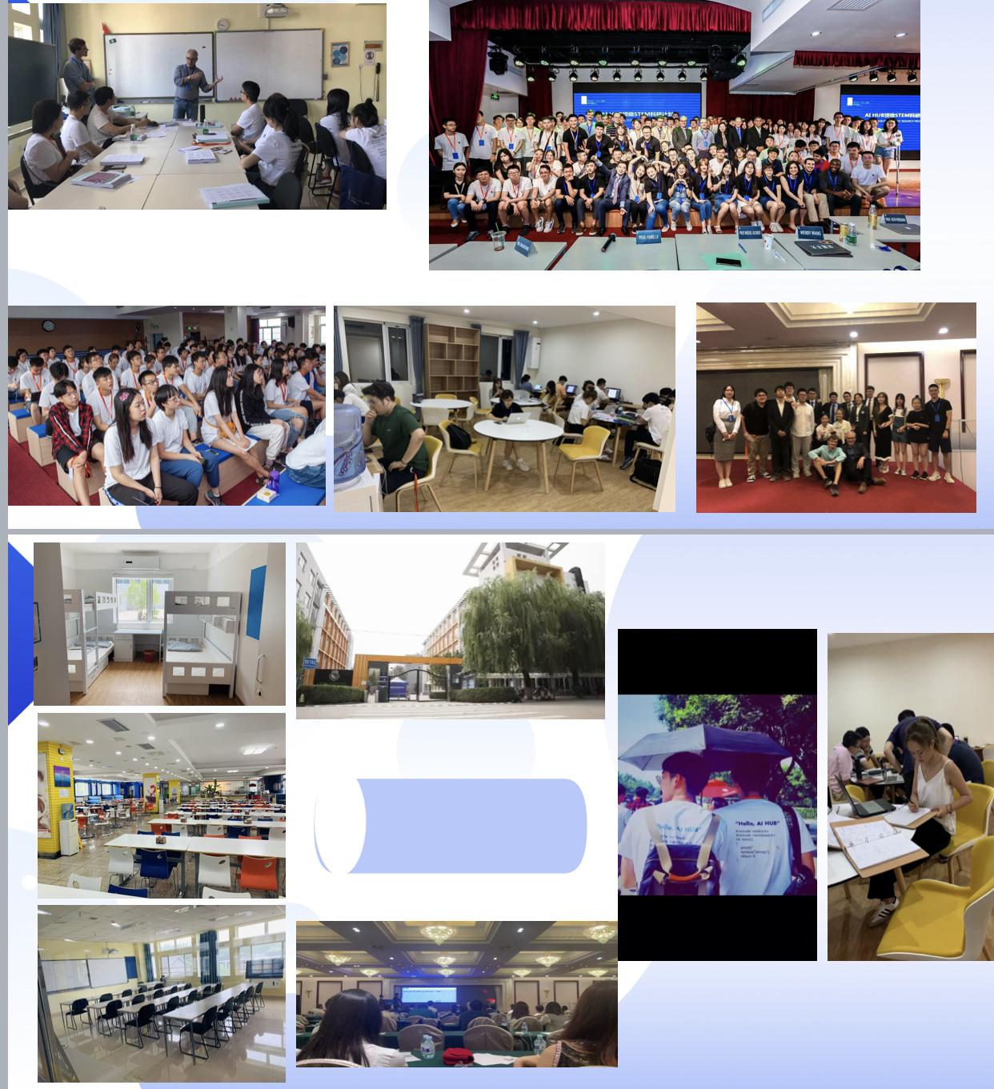
Core Programs
Online Research Seminar
Online Individualized Seminar
Onsite Research Bootcamp

Slide 4


Online Research Seminar
1 month before the program
30 minutes introduction+15 minutes Q&A
Demo
Professor
14 contact hours
W1
2H Lecture+90M Mentor+45M TA
Mentor
11 contact hours
2H Lecture+90M Mentor+45M TA
W2
8 contact hours
4 Lectures
W3
2H Lecture+90M Mentor+45M TA
6 contact hours
4 sessions
2H Lecture+90M Mentor+45M TA
W4
4 contact hours
2 Research Seminars
W5
2H Research Seminar+90M Mentor+45M TA
3 contact hours
2 presentation skills
2H Research Seminar+90M Mentor+90M TA
W6
2 contact hours
Final Presentation
W7
2H Final Presentation
Attend a 2-hour
Final Presentation
5 weeks taught by GEC researchers
Writing
Notes:
The Online Research Seminar are designed to take a group of 15-20 students on a guided tour through a specific academic topic, which allows them to deepen their knowledge towards the area and develop research skills by engaging in this academic experience. The program is similar to what you are teaching at your home institution, but is reduced in scope to fit the 7-week length. This program is rolling based, so the starting time would be coordinated based on your schedule.
The program will last for 7 weeks. Before the program starts, we will need you to do an introductory demo class for potential students, helps to promote student recruitment.Once the program officially starts, for the first four weeks, you need to deliver the main content to students, each session of the week lasts 2 hours. If you think that's too long, you can have a 5-10 minutes break in the middle, but that's up to you.Week 5 and 6's sessions are review sessions where you will have a direct interaction/close conversation with students to provide them with close guidance on finishing their project. You will need to review students' progress in preparing the final project. You can let students report the progress group by group or you can also use the function 'Break out rooms' to do this.
Then the final week's seesion (week 7) is the time for students to present their learning outcomes/achievements They do this either in group or individually. This session will last for around 2 hours.
Because what we are doing is nondegree, which mean students will not receive any diploma from us. What we can give them is an evaluation letter which reflects their performance during the program. On that letter, they will be able to see the letter grade of their partcipation, assignments and project, as well as some qualitative comments from you. We will need you to keep record of students performance during the program, to be able to provide students with this final evaluation after the program is finished.
Apart from your lecture each week, students will also have mentor sessions. Mentor sessions are conducted by PhD students in the relevant field as a supplementary session to your lectures. Your could recommend your own TA or PhD student to us. Otherwise, we'll find a mentor for you based on your requiremetns. On the right hand side, you could see the contact hours of the mentor. The mentor will also need to attend students' final presentation session in week 7.
Apart from the lecture and mentor session, there will also be a Chinese TA holding regular contact hours each week to help students to address students questions and monitor their attendance.
After seven week's program, students will enter into a 5-week academic writing training program led by a group of instructors who are good at academic writing. In most of the cases, students will produce a scientific manual transcript based on what they have learned from your class.
After seven week's program, students will enter into a 5-week academic writing training program led by a group of instructors who are good at academic writing. Therefore, in order to transit students to this additional program smoothly, it would be good if you could make the topic of the final project more open-ended extendible and exploratory, because students will produce the scientific manual transcript based on this.(if the professor ask about the connection and why we have this additional program) What we are doing is to prepare students for their future learning, which means that we hope our students not only have a solid knowledge base in the area, but also to possess scitific research skills. There is no doubt that research skills are essential and critical for students to have especially for those who want to apply for top universities. But we found that most of the Chinese students find doing academic research challenging/lacked the ability to do academic research/'s ability to academic research is insufficient. Therefore, we want to provide this kind of opportunity for them to develop/practice their research skills, which at the same time will make their learning experience with us more complete.

Slide 5
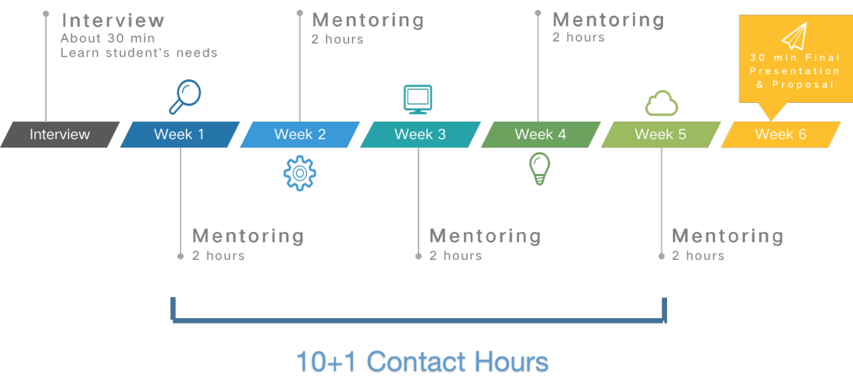
Online Individualized Program
Notes:
Online Individualized Program is a one-on-one program. It enables the student to develop more in-depth interest and investigate on the specific topic under the individualized mentoring and guidance of an expert in the field. The course focuses on specific topics of interest to that student. They are generally research-based. In some cases, these mentoring courses will produce a major research paper. If you are interested in the program, we'll put you in our instructor pool. Once we receive request from a student, we will mantch you with the student.
Interview with the student, max 30 minutes;
Week 1-5: 5 live online sessions, 2 hours each：instructor and student will need to go through the content
Week 6: Final presentation：dedicated for students to present their learning outcome/results in the form of an oral presentation or research proposal agreed by the instructor and the student
We understand that 6-week is too short to conduct a complete, bueautiful research. So we do not expect students to complete the whole research during your program. Rather, we expect the program to be an opportunity for students to learn some important knowledge about the topic/field as well as some essential research skills needed for conducting research. If the student is really interested in the topic/field and decides to go steps further or generate paper/articles for journals, he will be served by GEC's another program.

Slide 6
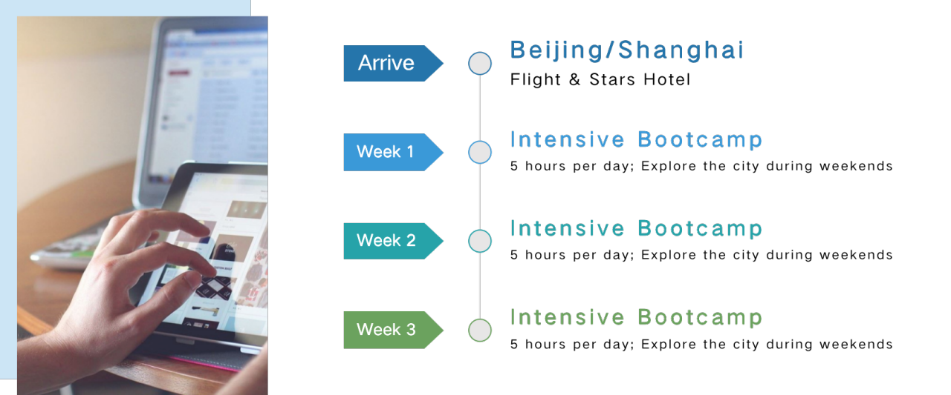
Onsite Research Bootcamp: AI HUB (Sample Schedule)
Notes:
On-site Research Bootcamp. It happens during Summer and Winter vacations. They are thematic programs. But currently due to the COVID-19, we are not running these programs currently. If you are interested in this on site programs in the future, GEC will defininately keep the faculty updated. But currently, we suggest you to start with Online programs.

Slide 7
Core Staff Teams
Faculty Outreach
Academic Management
Course Operation
Faculty Outreach managers are responsible for reaching out to professors and researchers and discuss the cooperation possibilities with them.
Academic managers are responsible for assisting and communicating with all faculty from academic and teaching quality perspective before and during all programs’ implementation.
Course coordinators are responsible for the logistics part of each specific program, as well as preparing and monitoring the students throughout the program.
(Note: there might be more than 1 contact person when you have multiple programs.)
Notes:
Faculty Outreach managers: the role Summer is playing right now. They will finalise the contract, the syllabus, the mentor candidate, the shceduling with the faculty.
Academic managers will take over the case after the the faculty outeach managers get their tasks done. They will thus be the first contact person for the faculty at GEC and monitor the entire implementation process of the program.
Academic managers will connect the faculty with the designated course coordinator as well once the program starts. Course coordinators will serve as the bridge between the faculty and the students.

Slide 8
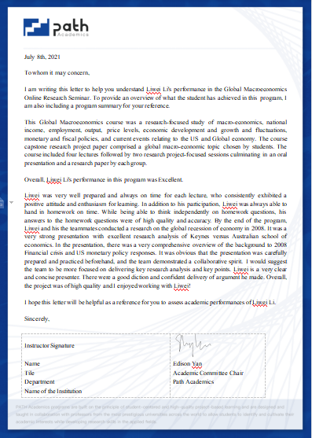
Evaluation
Notes:
The evaluation is normally divided into three parts:Participation, Assignments and Final Project.
Each student will receive a academic transcript and an evaluation letter (as shown) when he completes the program, where they will be able to see the letter grade, as well as some comments from the teaching team that qualitatively decribe ther performance durng the program.
What happens after that- students might approach the teaching team to request a recommendation for application purposes.

